Slide 1
Introduction
"Code Enforcement is the prevention, detection, investigation and enforcement of violations of statutes or ordinances regulating public health, safety, and welfare, public works, business activities and consumer protection, building standards, land-use, or municipal affairs.
A code enforcement officer is responsible for evaluating private properties and public grounds against local codes, answering citizen questions about the codes, and issuing citations for code violations. The officer may or may not be a certified police or peace officer. Code enforcement officers work to maintain an attractive, safe community, which helps improves both property values and the quality of life of those in the community.

Slide 2
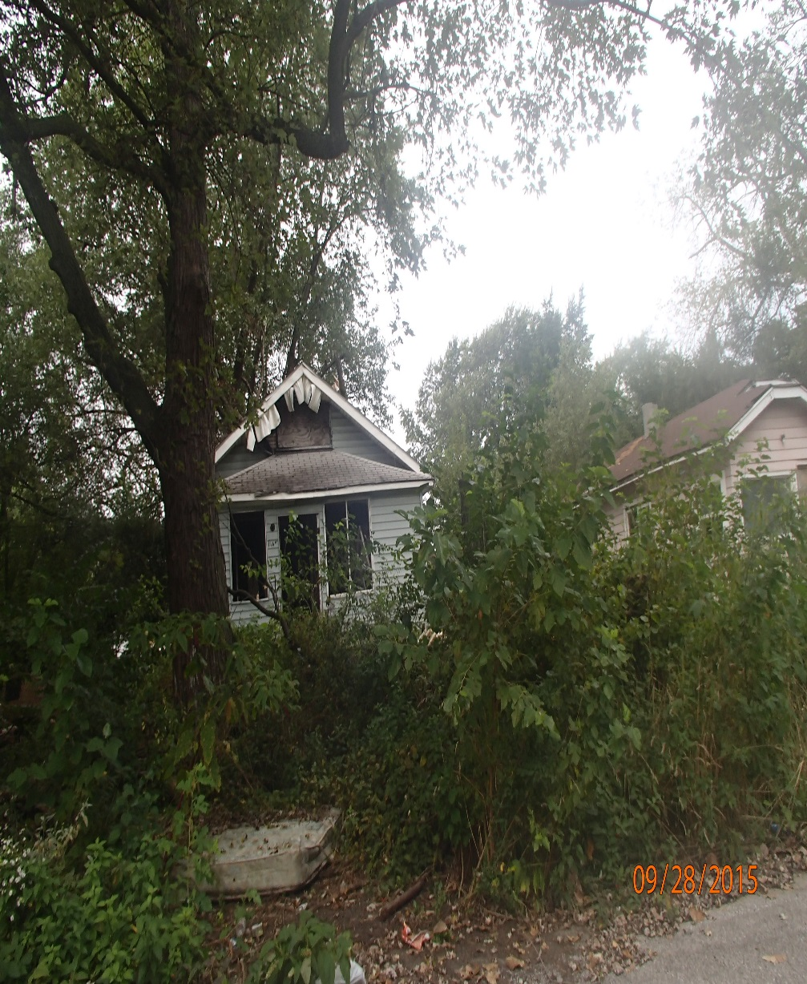
Overview
Code Enforcement’s Goal is to eliminate Blight by making the owners of properties like this liable.
Locate the owner
Cite
Bring to Court and begin the Court process.

Slide 3
Top Ten Reasons a Citation is issued
Not maintaining lawns on front, sides or rear.
Dumping on private or public property.
High weeds/tree branches
Abandoned vehicles on blocks or jacks, two or more flat tires, dismantled, expired plates or in operable.
Parking on front or rear lawns
Open burning(leaves or rubbish)
Obstruction of streets/sidewalks
Unnecessary storage & debris
Signage- it’s unlawful to erect, place, or stand, any signs temporarily or permanently between the property line and the curb.
Not maintaining all fences

Slide 4
Court Process
Code goes out to Cite the owner
Citation is mailed out with Court date
Defendant appears before the Judge to adhere to violation
Defendant either corrects the violation(s) or ask the Judge for more time to correct, defendant is usually granted thirty(30) days to correct and reappear before the Judge. At this time Defendant is assessed a fine to pay.
This process can take up to sixty days(60) or more to complete.

Slide 5
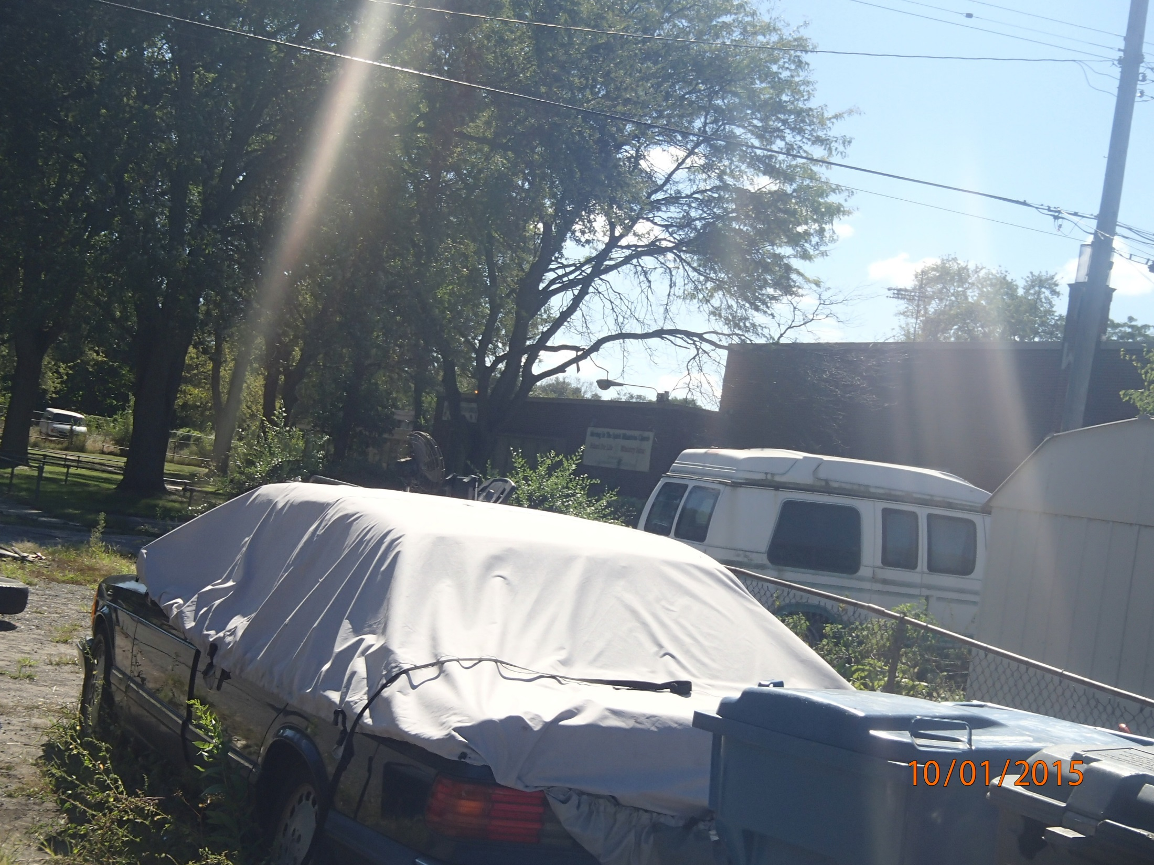
Summary
Briefly review what was presented
Identify ways to apply training
Request feedback on training session

Slide 6
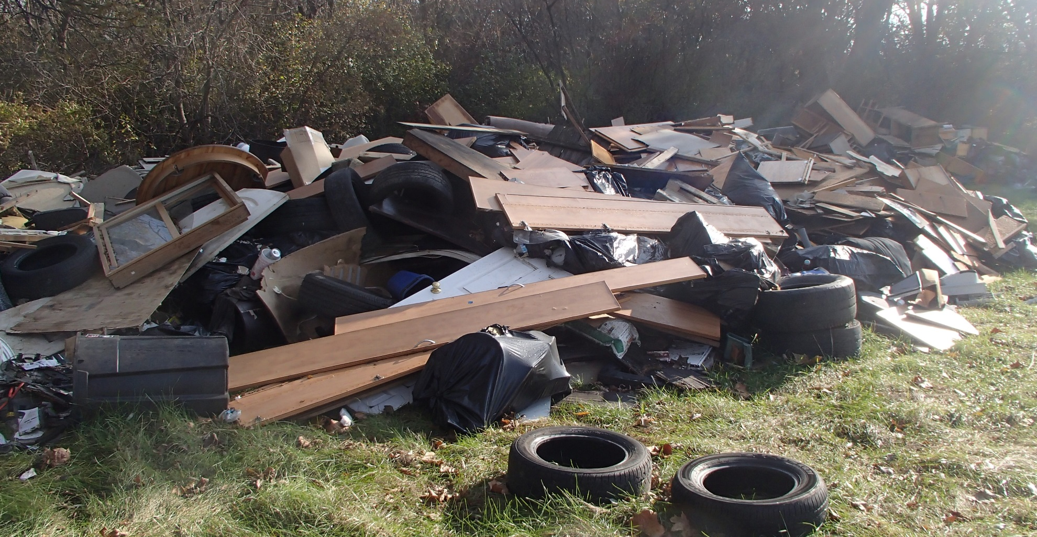
Illegal Dumping
This type of violation may result in jail time and or fines.

